Slide 1

Creative Problem-Solving
12 July 2024
HOPE XV
St John’s University
Gregory Carpenter, DrPH, FRSA
Chief Security Officer
KnowledgeBridge International

Slide 2
Creative Problem-Solving
IQ
Dork
Socially
Awkward
Nerd
Geek
Stalker
Obsession

Slide 3











Gregory Carpenter

Slide 4
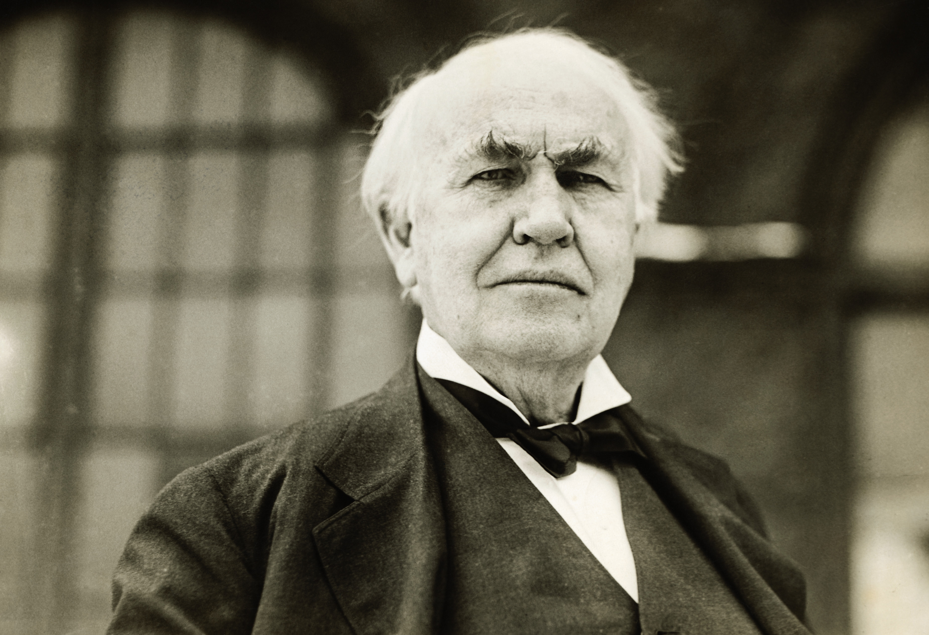

What is Creativity?
The ability to make or otherwise bring into existence something new, whether a new solution to a problem, a new method or device, or a new artistic object or form.
- Kerr, Barbara. "creativity". Encyclopedia Britannica, 2 Jul. 2024, https://www.britannica.com/topic/creativity. Accessed 8 July 2024.

Slide 5
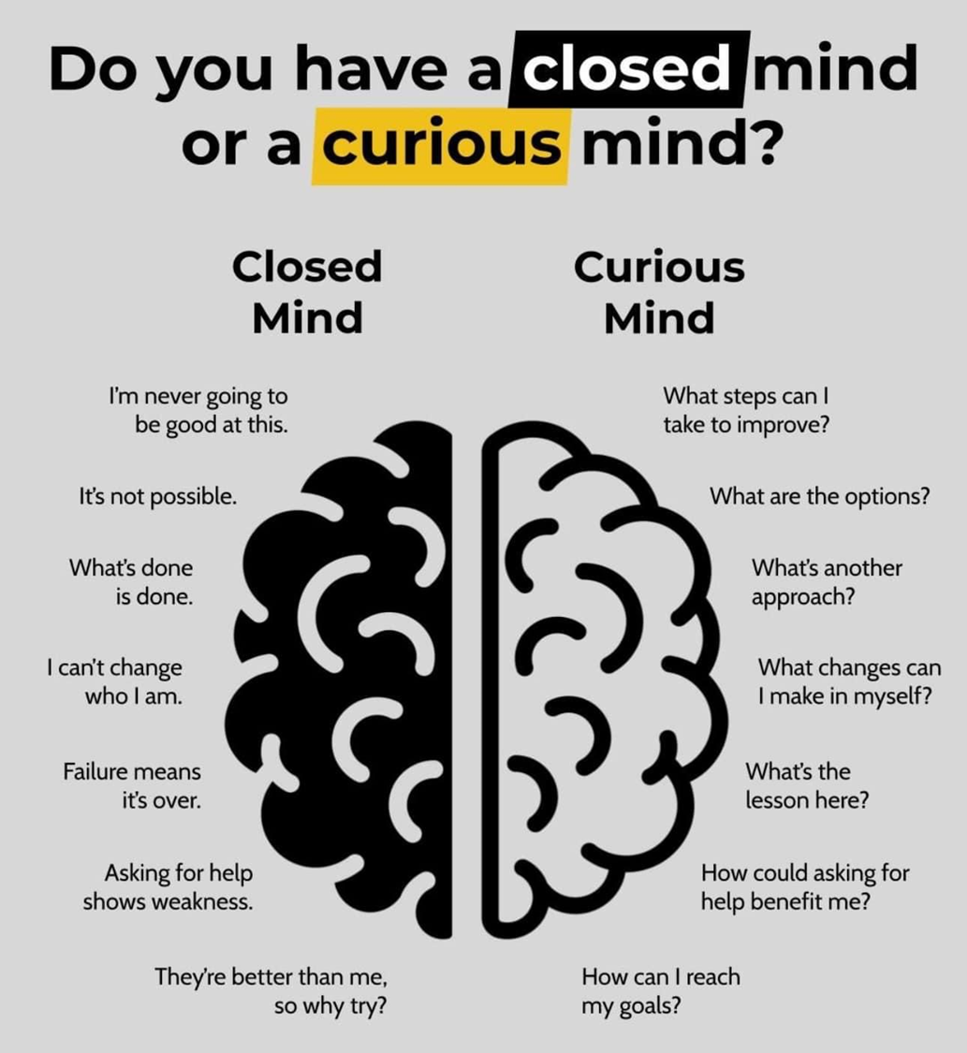
Can You Be Creative?

Slide 6
Creative Problem-Solving Tools
Tools for Generating Options
Tools for Focusing Options
Brainstorming
  W/Post-it®
  Brainwriting
Forced Fitting
Imagery Trek
Ladder of Abstraction
Morphological Matrix
SCAMPER
Advantages, Limitations, Unique Qualities, Overcome Limitations (AULO)
Evaluation Matrix
Criteria
Highlighting
Musts/Wants
Paired Comparison Analysis
Short/Medium/Long (SML)

Slide 7
Tools for Generating Options
Brainstorming
  W/Post-it®
  Brainwriting
Forced Fitting
Imagery Trek
Ladder of Abstraction
Morphological Matrix
SCAMPER
Visually Identifying Relationships

Slide 8
Brainstorming
W/Post-it®
Brainwriting
Option Generating Tool
Brainstorming is designed to generate many, varied, and unusual options while starting the flow of option generation for any other tool.

Slide 9
Brainstorming
W/Post-it®
Brainwriting
Rules for Brainstorming
Readable – Write clearly, legibly, and large enough to see.
Concise – Be Brief
Specific – Share the essence of the option

Slide 10
Imagery Trek
Option Generating Tool
Unusual options or highly innovative options are needed

Slide 11
Imagery Trek
Rules for Imagery Trek
Identify a List of Random Words.
Create and Record Images.
Develop Fuzzy Connections.
Develop Concrete Connections.

Slide 12
Ladder of Abstraction
Option Generating Tool
Explores a task or requirement in either a broader or more focused manner

Slide 13
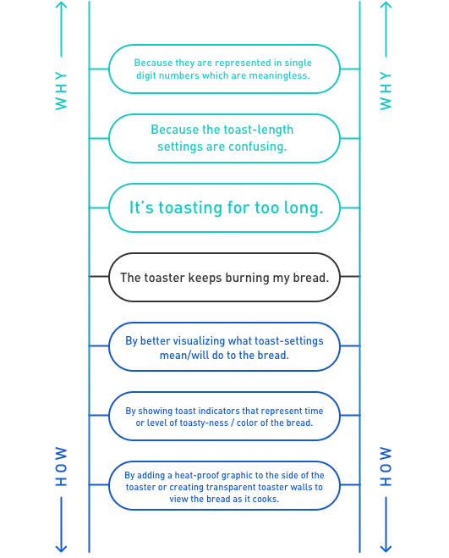
Ladder of Abstraction

Slide 14
Morphological Matrix
Option Generating Tool
Combines elements from several attributes of the task
Stimulate incremental change
Produce many options
Explore new combinations within the task

Slide 15
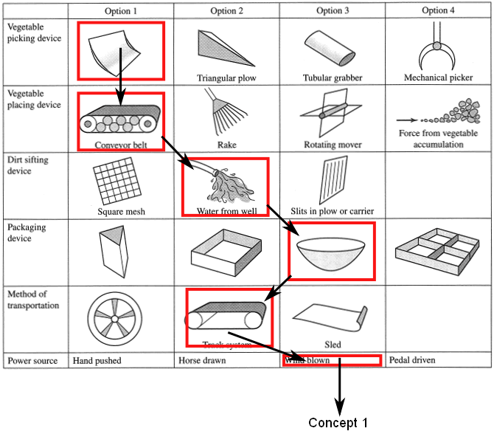
Morphological Matrix

Slide 16
Brainstorming Enhancements
SCAMPER
Force-fitting

Slide 17
SCAMPER
Brainstorming Enhancements
This tool is designed to stimulate break-through thinking.

Slide 18
SCAMPER
Rules for SCAMPER
Substitute
Combine
Adapt
Modify
Put to other uses
Eliminate
Rearrange - Reverse

Slide 19
Force Fitting
Brainstorming Enhancements
Force-fitting is an idea-generating tool that involves making unusual connections between ideas or items that don’t normally fit together.

Slide 20
Force Fitting
Rules for Force Fitting
Don’t evaluate your ideas as you generate them. Ideas are potential paths to follow, neither good nor bad.
The more ideas you have, the more ideas you will tend to come up with.
Don’t ignore silly or odd ideas; they could have potential down the road.
Consider combining ideas as you go along.

Slide 21
Brainstorming Exercise
Exercise:
Future Technologies That Could Transform Everyday Life

Slide 22
Brainstorming Exercise
Defer Judgement
Strive for Quantity
Seek Combinations
Freewheel

Slide 23
Brainstorming Exercise
Step 1: Generate Ideas
Only one potential technology per Post-it note.
Think broadly and consider different aspects of humanity or nature.

Slide 24
Brainstorming Exercise
Future Technologies That Could Transform Everyday Life
Defer Judgement
Strive for Quantity
Seek Combinations
Freewheel

Slide 25
Brainstorming Exercise
Step 2: Group Discussion
Have participants share their Post-it notes one by one.
Stick each note on the whiteboard or surface.
Facilitate a brief discussion after each note is placed to clarify or elaborate on the idea.
Use different colors to group similar ideas (If available)

Slide 26
Tools for Focusing Options
Advantages, Limitations, Unique Qualities, Overcome Limitations (AULO)
Evaluation Matrix
Criteria
Highlighting
Musts/Wants
Paired Comparison Analysis
Short/Medium/Long (SML)

Slide 27
Advantages, Limitations, Unique Qualities, Overcome Limitations (AULO)
Tools for Focusing Options
Advantages, Limitations, Unique Qualities, Overcome Limitations (AULO) is a focusing tool used to analyze promising options.

Slide 28
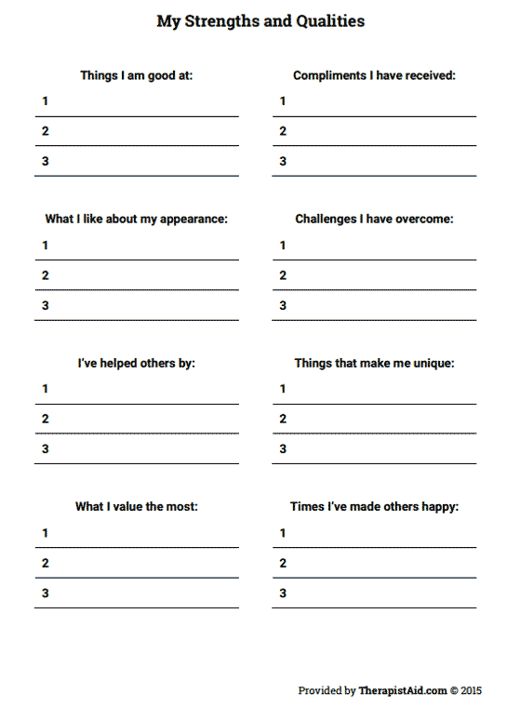
Advantages, Limitations, Unique Qualities, Overcome Limitations (AULO)

Slide 29
Evaluation Matrix
Tools for Focusing Options
Evaluation Matrix provides a structured approach for evaluating options against specific criteria.

Slide 30
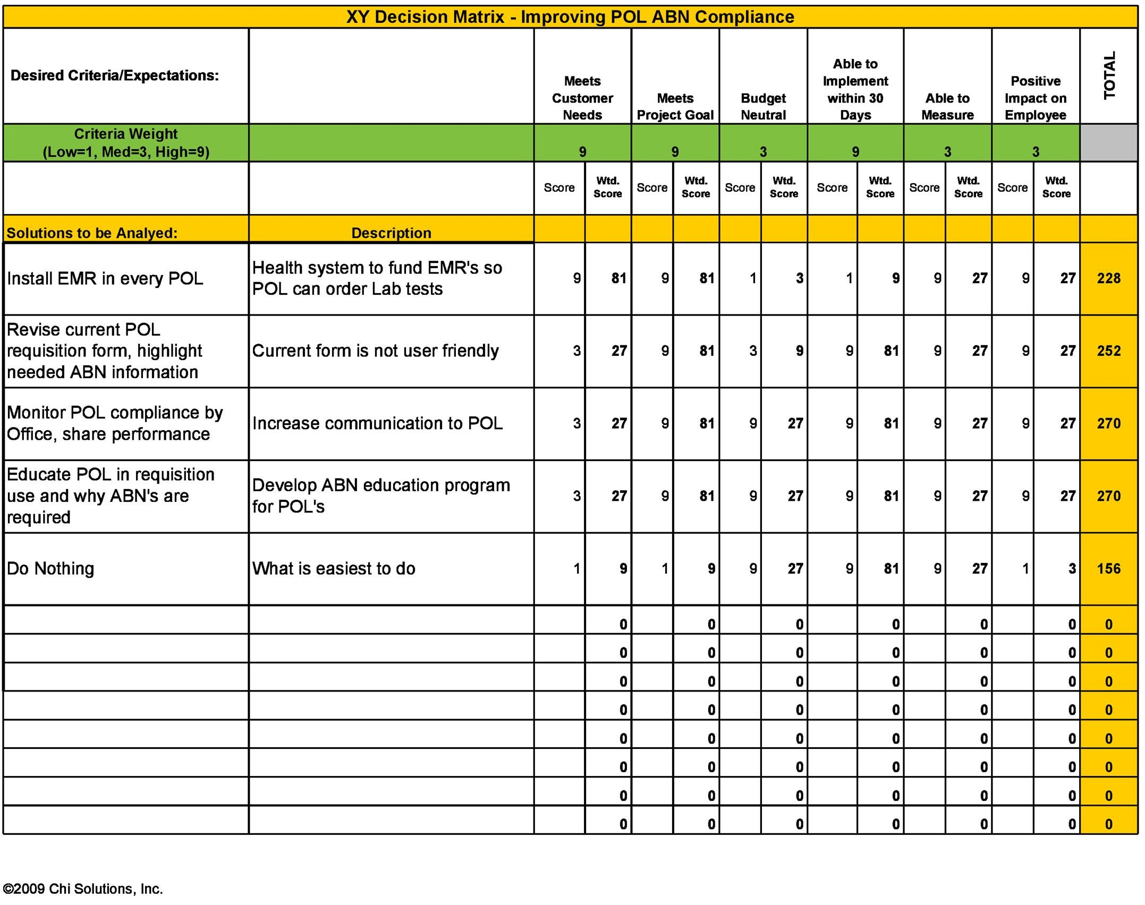
Evaluation Matrix

Slide 31
Highlighting
Tools for Focusing Options
Highlighting helps specific options stand out so they can be more thoroughly evaluated.

Slide 32
Highlighting
You do know how to highlight, correct?

Slide 33
Musts / Wants
Tools for Focusing Options
Musts / Wants helps prioritize options.

Slide 34
MUSTS | WANTS
Musts / Wants

Slide 35
Paired Comparison Analysis
Tools for Focusing Options
Paired Comparison Analysis helps prioritize options by comparing them against each other one pair at a time.

Slide 36
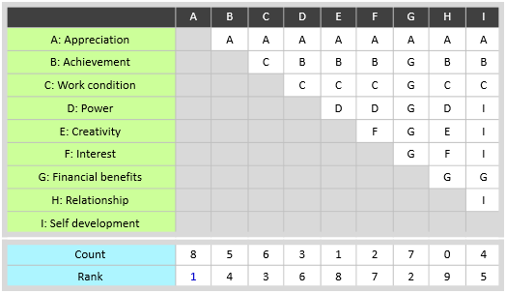
Paired Comparison Analysis

Slide 37
SML (Short, Medium, Long)
Tools for Focusing Options
SML (Short, Medium, Long) helps prioritize options by time.

Slide 38
Short | Medium | Long
SML (Short, Medium, Long)

Slide 39
Advantages, Limitations, Unique Qualities, Overcome Limitations (AULO) Exercise
Exercise:
Select the most advantageous future technologies that could transform everyday life.

Slide 40
Advantages, Limitations, Unique Qualities, Overcome Limitations (AULO) Exercise
Advantages
Limitations
Unique Qualities
Overcome Limitations

Slide 41
Advantages, Limitations, Unique Qualities, Overcome Limitations (AULO) Exercise
Exercise:
Select the most advantageous future technologies that could transform everyday life.

Slide 42
You Have Saved Humanity
Congratulations, but the correct answer is 42.

Slide 43
References
Basadur, M. (1994). Simplex: A flight to creativity. Buffalo, NY: CEF Press.
Besemer, S. P., & O'Quin, K. (1987). Creative product analysis: Testing a model by developing a judging instrument. Journal of Creative Behavior, 21(4), 219-231.
Bodmer, S., Kilger, M., Carpenter, G., & Jones, J. (2012). Reverse deception: Organized cyber threat counter-exploitation. McGraw-Hill Education.
Christensen, C. M. (2013). The innovator's dilemma: When new technologies cause great firms to fail (Reprint ed.). Boston, MA: Harvard Business Review Press.
Dacey, J. S. (1989). Fundamentals of creative thinking. Lexington, MA: D. C. Heath & Co.
Haefele, J. W. (1962). Creativity and innovation. New York, NY: Reinhold.
Isaksen, S. G., Dorval, K. B., & Treffinger, D. J. (1994). Creative approaches to problem solving. Dubuque, IA: Kendall/Hunt Publishing.

Slide 44
References
Isaksen, S. G., Treffinger, D. J., & Dorval, K. B. (1997). The creative problem solving framework: An historical perspective. Sarasota, FL: Center for Creative Learning.
Isaksen, S. G. (Ed.). (1987). Frontiers of creativity research: Beyond the basics. Buffalo, NY: Bearly Limited.
Johnson, S. (2010). Where good ideas come from: The natural history of innovation. New York, NY: Riverhead Books.
Kelley, T., & Kelley, D. (2013). Creative confidence: Unleashing the creative potential within us all. New York, NY: Crown Business.
Kelley, T. (2001). The art of innovation: Lessons in creativity from IDEO, America's leading design firm. New York, NY: Crown Business.
Kerr, Barbara. "creativity". Encyclopedia Britannica, 2 Jul. 2024, https://www.britannica.com/topic/creativity. Accessed 8 July 2024.
Michalko, M. (2006). Thinkertoys: A handbook of creative-thinking techniques (2nd ed.). Berkeley, CA: Ten Speed Press.

Slide 45
References
Michalko, M. (2001). Cracking creativity: The secrets of creative genius. Berkeley, CA: Ten Speed Press.
Mootee, I. (2013). Design thinking for strategic innovation: What they can't teach you at business or design school. Hoboken, NJ: Wiley.
Parnes, S. J. (Ed.). (1992). Sourcebook for creative problem solving: A fifty year digest of proven innovation processes. Buffalo, NY: CEF Press.
Pink, D. H. (2006). A whole new mind: Why right-brainers will rule the future. New York, NY: Riverhead Books.
Ries, E. (2011). The lean startup: How today's entrepreneurs use continuous innovation to create radically successful businesses. New York, NY: Crown Business.
Joyce, M., Isaksen, S., Davidson, F., Puccio, G., Coppage, C., & Maruska, M. (1997). An introduction to creativity (2nd ed.). Acton, MA: Copley Press.

Slide 46
Creative Problem-Solving
IQ
Dork
Socially
Awkward
Nerd
Geek
Stalker
greg.carpenter@kbi.ai
Gregory Carpenter, DrPH, FRSA
Chief Security Officer
KnowledgeBridge International
Obsession

